Slide 1
Command Pattern
Cüneyt GÖKBULUT

Slide 2
Motivation
Sometimes it's necessary to issue requests to objects without knowing anything about the operation being requested or the receiver of the request.
This pattern is used to represent and encapsulate all the information needed to call a method at a later time

Slide 3
Motivation
INVOKER
OBJECT
JOB
JOB
JOB
JOB
JOB
JOB
JOB
JOB
JOB
JOB
Encapsulate them as Concrete Command Objects.
Make the Invoker Object use these Objects.

Slide 4
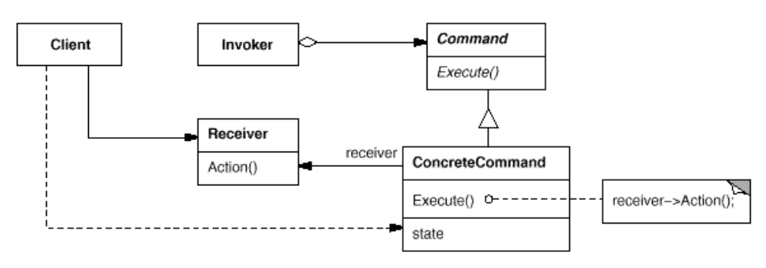
Structure

Slide 5
Participants
Command
  declares an interface for executing an operation.
ConcreteCommand
  defines a binding between a Receiver object and an action.
  implements Execute by invoking the corresponding operation(s) on Receiver.
Client
  creates a ConcreteCommand object and sets its receiver.
Invoker
  asks the command to carry out the request.
Receiver
  knows how to perform the operations associated with carrying out a request.

Slide 6

Man: Client
Remote Controller: Invoker Object
TV: Receiver Object
Buttons: Concrete Command Objects

Slide 7
Demo
Implementation of previous example

Slide 8
Usage Areas
Progress Bars
  Suppose a program has a sequence of commands that it executes in order. If each command object has a getEstimatedDuration() method, the program can easily estimate the total duration. It can show a progress bar that meaningfully reflects how close the program is to completing all the tasks.

Slide 9
Usage Areas
GUI buttons and menu items
  In Swing programming, an Action is a command object. In addition to the ability to perform the desired command, an Action may have an associated icon, keyboard shortcut, tooltip text, and so on. A toolbar button or menu item component may be completely initialized using only the Action object.

Slide 10
Usage Areas
Networking
  It is possible to send whole command objects across the network to be executed on the other machines, for example player actions in computer games.

Slide 11
Other Usage Areas
Parallel Processsing
Wizards
Transactional behavior
Thread pools
Macro recording
Mobile Code
UNDO/REDO (IMPORTANT ONE)

Slide 12
Demo
Undoable Command

Slide 13
References
Design Patterns -Elements of Reusable Object-Oriented Software-GOF-Command Pattern
http://en.wikipedia.org/wiki/Function_object
http://en.wikipedia.org/wiki/Command_pattern
http://www.java2s.com/Code/Java/Design-Pattern/CommandPattern2inJava.htm
http://www.codeproject.com/KB/java/FunctionalJava.aspx
http://userpages.umbc.edu/~tarr/dp/lectures/Command.pdf
http://www.javaworld.com/javaworld/jw-06-1998/jw-06-undoredo.html

